Slide 1
Survey of Graphics and Games

Slide 2
Outline
Overview of computer graphics
  Coursework
  Research
Programming using game engines
Computer game and animation industry information

Slide 3
Common computer graphics courses (taken from 2013 joint study by ACM and IEEE)
Fundamental Concepts
Basic Rendering
Geometric Modeling
Advanced Rendering
Computer Animation
Visualization

Slide 4
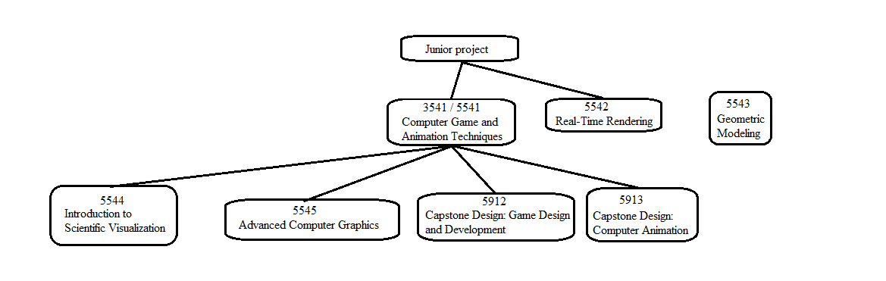
Computer graphics courses at OSU
Course offering trends (subject to change):
Multiple sections each semester – 3541
One section each semester – 5542, 5912
One section each spring – 5543
One section every other spring – 5544, 5545
Only on demand (express interest in the advising office):
5913
Follow-up to 3541 (analogous to AI 2)
Human Computer Interaction
Interested in technical artistry? Look into ACCAD courses (http://accad.osu.edu/academics/courses.html)

Slide 5
Game engines
Unity3D
Unreal Engine 4
Source 2
More exhaustive or comparative lists:
  http://en.wikipedia.org/wiki/List_of_game_engines
  http://www.moddb.com/engines/top
  http://www.pixelprospector.com/the-big-list-of-game-making-tools/

Slide 6
Unity3D
Development
  Develop on Windows or Mac
  Games easily ported to run on many platforms
  Engine written in C/C++
  Scripting in C# or Javascript
  Lots of documentation and tutorials
  Not geared towards specific game genres
Licensing
  Free for personal use
  Doesn’t play well with academic organizational use

Slide 7
Unity example script
using UnityEngine;
using System.Collections;
public class Spin : MonoBehaviour
{
public float speed = 10f;
void Start() { // code to run when start is pressed }
void Update ()
{
transform.Rotate(Vector3.up, speed * Time.deltaTime);
}
}

Slide 8
Development in Unity3D vs. XNA
Image source:
http://code.google.com/p/bitverse-unity-gui/
Image source: http://docs.unity3d.com/Manual/UsingComponents.html

Slide 9
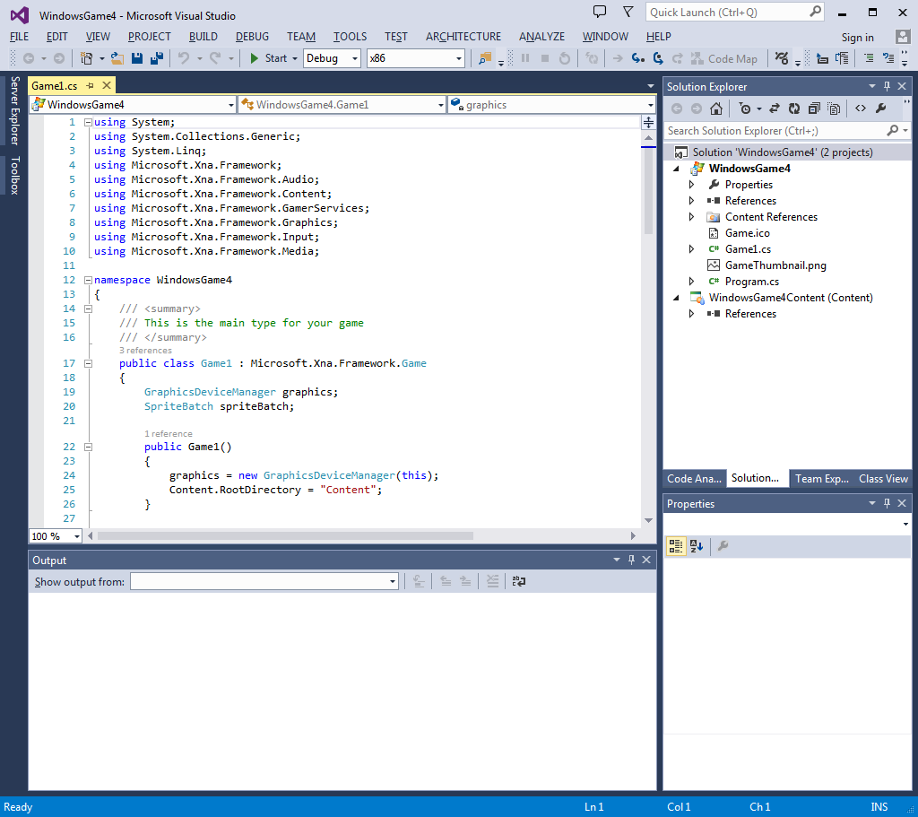
Development in Unity3D vs. XNA
Subset of XNA framework namespaces
Microsoft.Xna.Framework Provides commonly needed game classes such as timers and game loops.
Microsoft.Xna.Framework.Audio Contains low-level application programming interface (API) methods that can load and manipulate XACT-created project and content files to play audio. Microsoft.Xna.Framework.Content Contains the run-time components of the Content Pipeline. Microsoft.Xna.Framework.Graphics Contains low-level application programming interface (API) methods that take advantage of hardware acceleration capabilities to display 3D objects.
Microsoft.Xna.Framework.Input Contains classes to receive input from keyboard, mouse, and Xbox 360 Controller devices.
Microsoft.Xna.Framework.Net Contains classes that implement support for Xbox LIVE, multiplayer, and networking for XNA Framework games.

Slide 10
Unreal Engine 4
Development
  Develop on Windows or Mac
  Slightly more artist/designer friendly
  Engine written in C++ and C#
  Scripting in C++
  Less learning resources than Unity but growing
  Geared towards first/third person shooters and action genres
Licensing
  Free for personal use
  Free for academic organizational use
  Frequent version updates

Slide 11
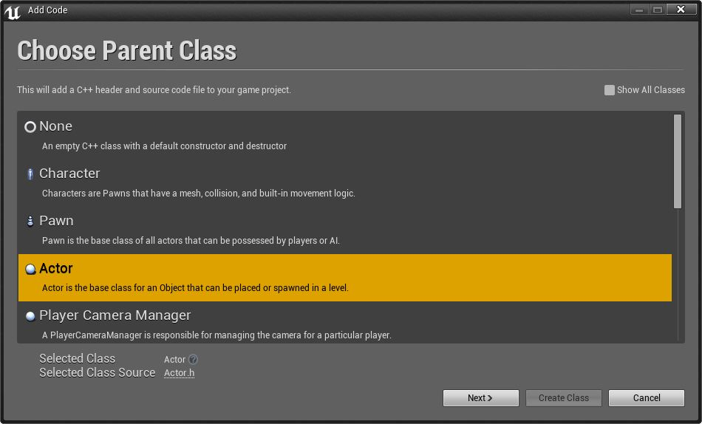
UE4 scripting example

Slide 12
UE4 scripting example

Slide 13
Source 2
Source 1
  Written in C++
  Scripting languages (Squirrel, Lua, Gamemonkey, Python)
Source 2 not available yet, limited information at this time (coming out November 2015?)
Licensing
  Free for personal use
  Academic organizational use?

Slide 14
Jobs in the computer game industry
Artist
  Uses specialized tools to create art assets (concept art, textures, models, character rigs, etc.)
Designer
  Uses game engine to make scenes, levels, scenarios, gameplay, etc.
Technical Artist
  Uses art tools and does development, but with a specific focus area (modeling, shading, lighting, animation, etc.)
Developer (Technical Director in animation industry)
  Writes code that implements or extends functionality of artist tools and/or game engines
A broader summary of positions can be found here http://creativeskillset.org/creative_industries/games/job_roles

Slide 15
Developer areas
Game engine
  Graphics
  Animation
Artificial Intelligence
Sound
Game logic / scripts
User Interfaces
Networking
Databases
Development tools
Systems/Parallel programming

Slide 16
Animation companies
Pixar http://www.pixar.com/careers
Dreamworks http://www.dreamworksanimation.com/jobs/
Disney http://www.disneyanimation.com/careers

Slide 17
Game development opportunities
EA Sports http://www.easports.com/careers
Ohio Game Developer Association list http://www.ohiogamedev.com/
Lumos http://www.lumoscolumbus.com/
A blog article on the best companies to work for and the supporting study by IGDA

